Slide 1


Face Recognition with Real Time Attendance
PROJECT P7029
Project guide: Dr.K.V.Rajani
SHESHAGIRI RAO 222010306022
SAI SAMARTH 222010306023
HANISH KOLLA 222010306036
PRANAVSAI 222010305025

Slide 2
INTRODUCTION
Face recognition technology offers better accuracy compared to conventional methods.
Face recognition is one of the most important applications of image processing in the automated world.
By identifying individuals based on unique facial features, the system significantly reduces the risk of errors and ensures reliable attendance tracking.
Unlike other forms of biometric technology, such as fingerprint recognition, which captures identity by touching, a face recognition based attendance system manages a person without the approach of direct contact.
A touchless method such as a face recognition based attendance system is a successful preventive measure during the COVID-19 epidemic.

Slide 3

Problem Statement
The traditional methods of recording workplace attendance often rely on manual inputs, badge-based systems, or other means that require direct intervention by employees. These approaches can be time-consuming, prone to errors, and lack the capacity to adapt to the growing need for contactless and secure access control in modern workplaces.

Slide 4
Solution
The benefit of our approach is much greater representational efficiency: we achieve state-of-the-art face recognition performance using only 128-bytes per face.
Rather than using engineered features, we use a large dataset of labelled faces to attain the appropriate invariances to pose, illumination, and other variational conditions
Approach: Our approach is a purely data driven method which learns its representation directly from the pixels of the face

Slide 5

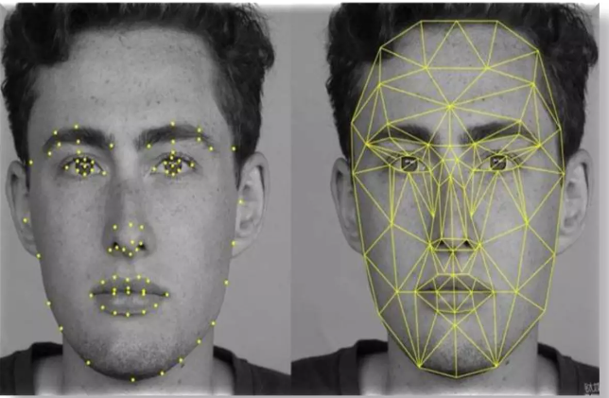

What is Face Recognition?
Face recognition is a method of identifying or verifying the identity of an individual using their face. Face recognition systems can be used to identify people in photos, video, or in real-time.

Slide 6

Why We Choose Face Recognition
It requires no physical interaction on behalf of the user.
It can use your existing hardware infrastructure, existing camaras and image capture
It is accurate and allows for high enrolment and verification rates.
It does not require an expert to interpret the comparison result.
Reasons
It is the only biometric that allow you to perform passive identification in a one to. Many environments

Slide 7

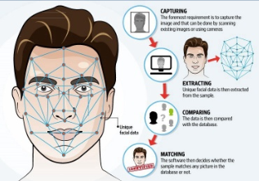
How Face Recognition works
Capture The first step is for the system to collect physical or behavioral samples in predetermined conditions and during a stated period of time.
Extraction Then, all this gathered data should be extracted from the samples to create templates based on them.
Comparison After the extraction, collected data is compared with the existing templates.
Matching The final stage of face detection technology is to make a decision whether the face's features of a new sample are matching with the one from a facial database or not. It usually takes just seconds.

Slide 8
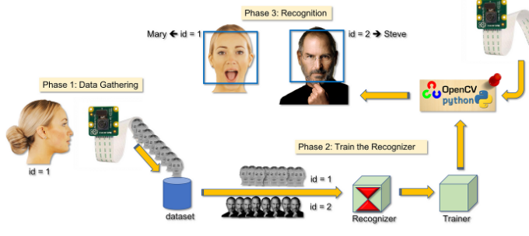

Slide 9




Cons
Image Quality
Angle
Storage
Complexity

Slide 10

Conclusion
face recognition using OpenCV with Python is a powerful and versatile technology that has the potential to revolutionize a wide range of applications, from security and surveillance to human-computer interaction and personalization.
Through the use of machine learning techniques, such as deep neural networks, OpenCV can accurately and reliably detect and recognize faces, even under challenging conditions.
This technology has the potential to enhance security systems, improve user experiences, and enable innovative applications in fields such as healthcare, retail, and entertainment

Slide 11

Reference
https://www.ijert.org/research/smart-attendance-system-using-opencv-based-on-facial-recognition-IJERTV9IS030122.pdf
https://www.researchgate.net/publication/341876647_Face_Recognition_based_Attendance_Management_System
https://www.sciencedirect.com/science/article/pii/S1877050921019232

Slide 12

THANK YOU

